Slide 1
Laser Marking Technology
- Ajith Srikanth

Slide 2
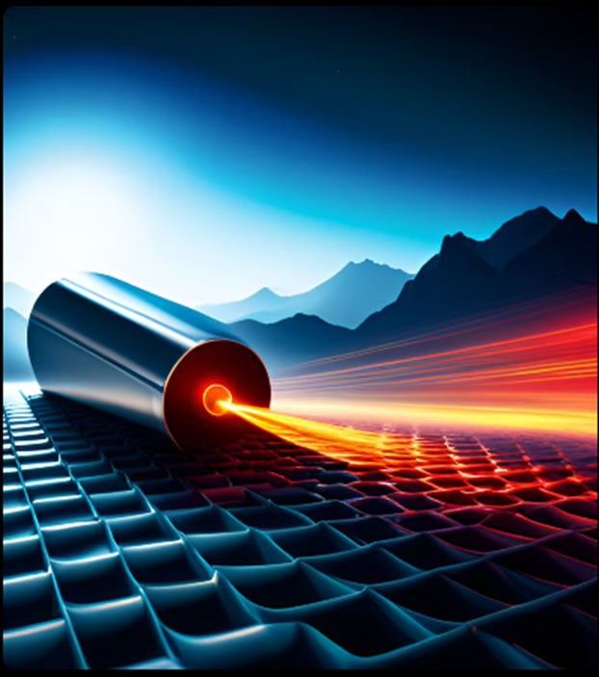
Introduction
LASER – Light Amplification by Stimulated Emission of Radiation
Laser marking machines utilize focused laser beams to create permanent marks or engravings on various materials.
They are crucial in industries like manufacturing, electronics, automotive, and medical devices.
Importance & Application
High Precision, Permanent Marking Solution Withstanding Wear & Tear
Traceability, product identification, branding, authentication and regulatory compliance.
Used in metals, plastics, ceramics & glass for marking serial numbers, barcodes & logos.
Notes:
Laser Marking is a prominent technology recently flourishing due to various reasons. This technology is was invented in 1964, which was a CO2 laser. Their Applications range from Manufacturing to Medical and Electronics to FMCG Industry. The need for this in industry is (Importance & Application). In HM3H, we have 4 Laser Markings in total from Mechatronics, Ritter and Videojet. Let’s Explore on the components required to use this technology. (1mins)

Slide 3
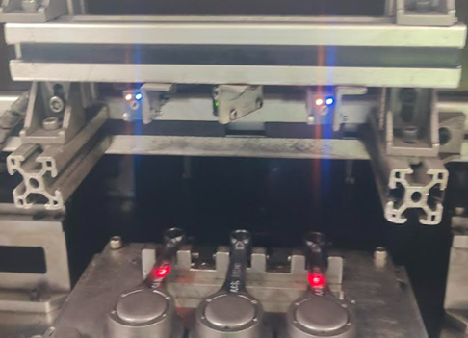
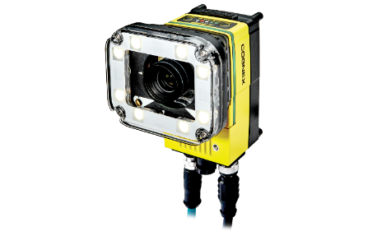
Working of Laser Marking
Laser Generation & Focusing:
Laser source emits a highly focused beam.
Optics system directs the beam to a small spot on the material's surface.
Material Interaction & Mark Creation:
Laser energy heats, melts, or vaporizes the material.
Creates a contrast between marked and unmarked areas.
Control Software & Precision:
Software controls laser parameters.
Laser follows the design pattern, such as QR codes.
Software controls laser parameters (intensity, speed, pattern).
Interprets design files (e.g., QR codes) to guide laser movement.
Ensures consistent and accurate marking.
Component Present Sensor
Vision Camera
Fixture
Loading & Unloading Area
Notes:
To understand better, lets understand the flow of the process. (2mins)

Slide 4
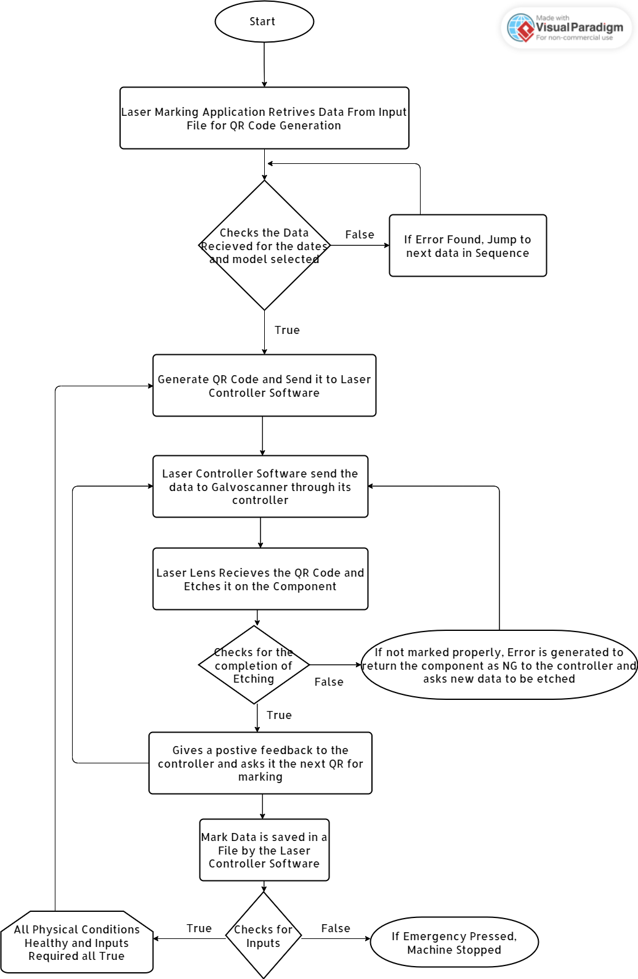
Process Flowchart

Slide 5
Principle of Laser
A laser is created when electrons in the atoms in optical materials like glass, crystal, or gas absorb the energy from an electrical current or a light. Few Terms associated with Laser are:
Material Removal Rate (m³/s)
Wavelength (nm)
Frequency (Hz)
Power (KWH)
Speed (m/s)
Material Removal Rate = Power x Speed / Energy
Energy = Power / Frequency
= 30000W/100000Hz
= 0.3 J/pulse
MRR = 30000 x 6000 / 0.3 = 6 x 10⁷ m³/s
Wavelength = 1064nm
Frequency = 100KHz
Power = 30KwH
Speed = 6m/s

Slide 6
Understanding Component Nomenclature
1 = Vendor
P = Year (2023)
J = Month (09)
E = Component Type (CS,CR,CH,CB)
5 Digits = Serial No
08 = Current Date
H = Haridwar Plant
H1PJ08E01360

Slide 7
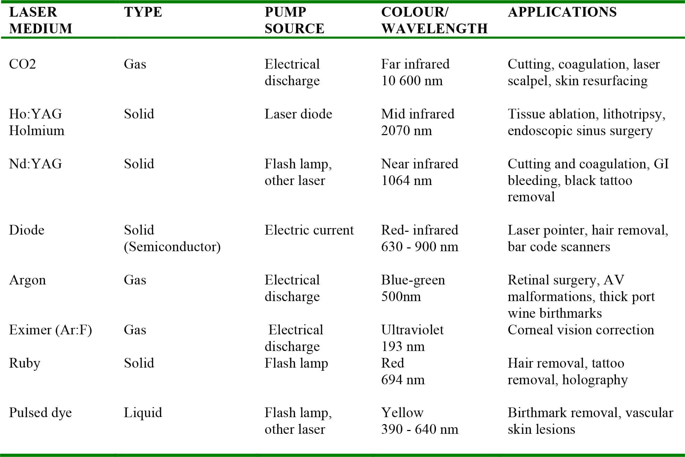
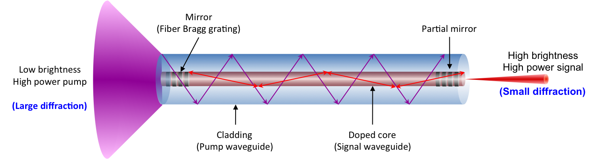
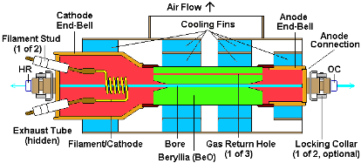
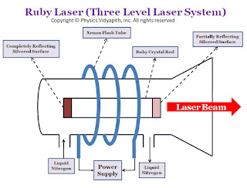
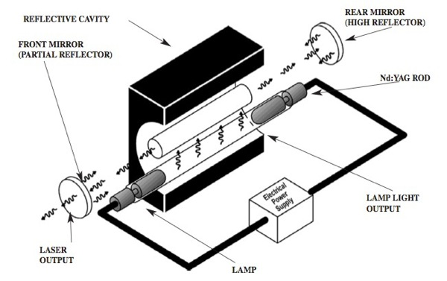
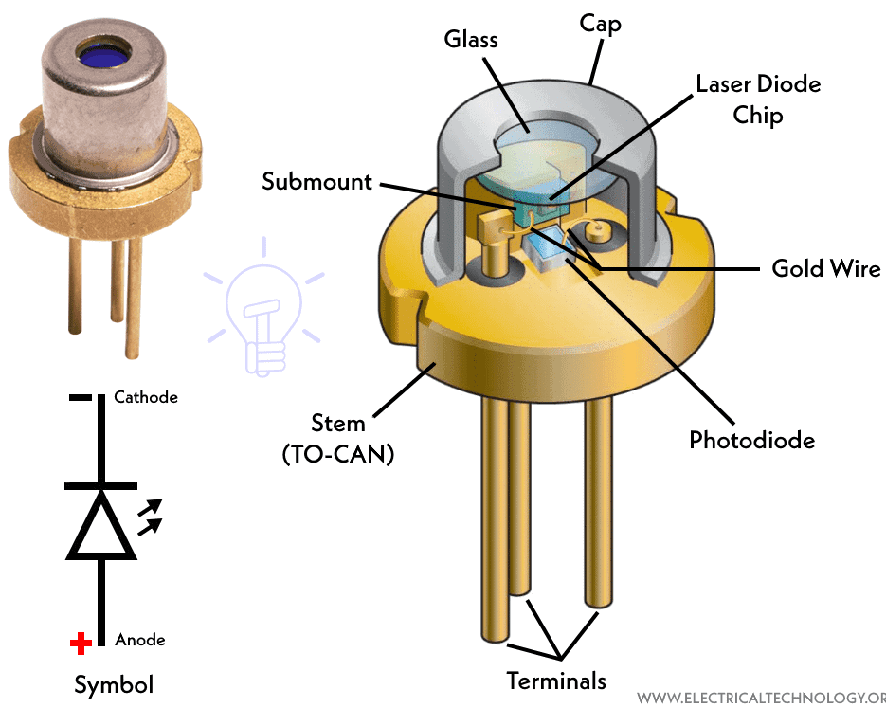
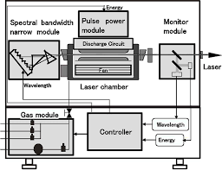
Components of Laser Marking
Types of Laser
Fiber
Nd:YAG
Diode
Argon
Ar:F (Eximer)
Ruby
Pulsed Dye

Slide 8
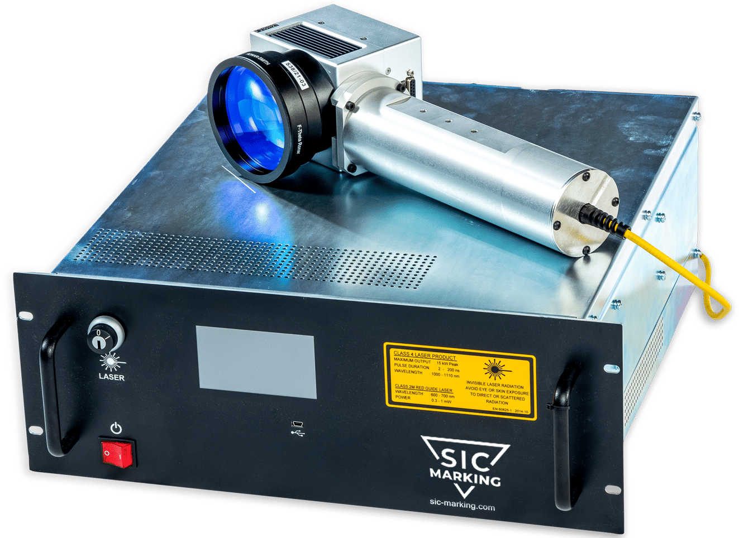
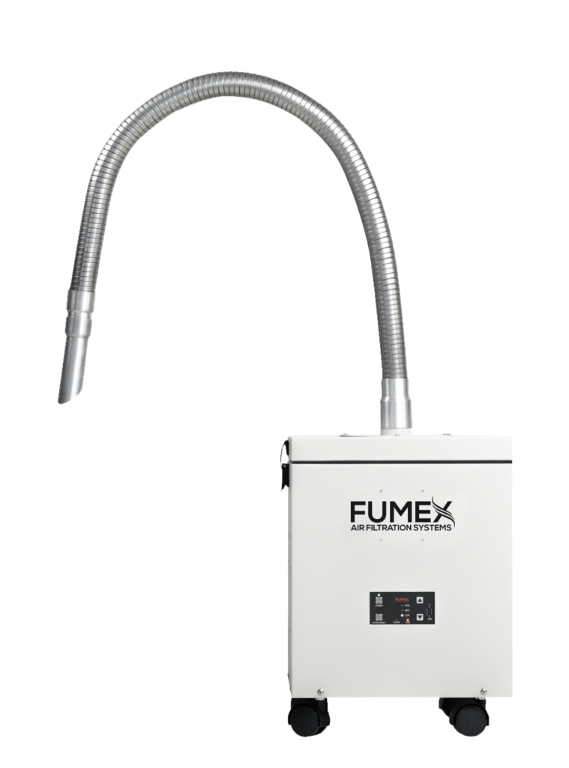
Components of Laser Marking
Optics System:
Galvanometer
Optical Fiber Cable
Controller Unit
Work Station:
Exhaust System:
Cooling system prevents overheating of the laser source.
Exhaust system removes fumes and debris generated during marking.
Essential for maintaining optimal performance and a safe working environment.
Component Present Sensor
Vision Camera
Fixture
Loading & Unloading Area
Notes:
Major Components like Laser Source, Optics System, Galvanometer, Work Station AkA Fixture & Ventilation Unit. There are about 5 types of laser source namely Fiber which is used in Metal (Used in HMCL), CO2 Laser which was the 1st ever laser to be developed and used on Non-Metallic Surface like Plastic used in FMCG, Nd:YAG (Yttrium aluminum garnet ) a cost laser source due to Yttrium Scarecity and used for Precision in Metallic Surfaces, Diode laser is used to mark any object with a matter of seconds and with lesser power, MOPA (Master Oscillator Power Amplifier) is a type of Diode Laser which produces the beam while the optical amplifier is used for boosting the output power and Green Laser aka “cold” marking laser as it marks materials without generating heat that can damage sensitive or even very thin materials like Food Wraps and Bottles. The main component of these machines is the Galvanometer, it contains small reflecting mirrors that are attached with a servo motor and they run as per the command generated by the controlling software to get the required marking on the object. They move rapidly within nanoseconds with accurate positioning that reflects and refracts the laser beam as per requirement when the Shutter is open. Shutter is also known as a stopper that does not allow the laser to reflect on the mirrors when the mirrors are moving in order to generate the required marking. As soon as the mirrors, stop moving the shutter opens to etch on the component.(5mins)

Slide 9
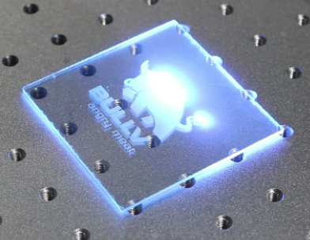
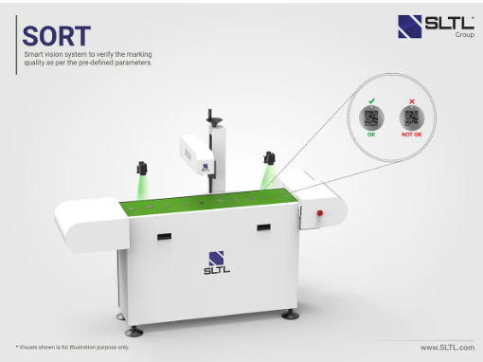
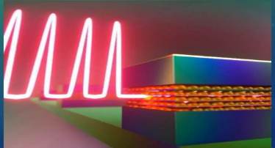
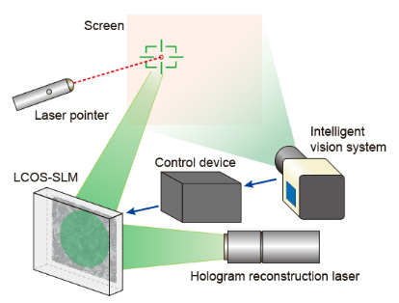
Future of Laser Marking Technology
Invisible Marking: Laser marks can be created beyond the visible spectrum, using UV or IR lasers, and revealed with specialized equipment.
Quantum Dot Marks: Quantum dots emit colors when exposed to lasers, enabling vibrant and versatile marks.
AI Optimization: AI-integrated laser systems adjust parameters like power and speed for accurate and consistent marks.
Microscopic Precision: Laser marks as small as micrometers find applications in electronics and medical devices.
Anti-Counterfeiting: Laser marks can be combined with holograms and micro text for complex anti-counterfeiting measures.
Notes:
So what future lies of Laser Marking Technology? Talking about a Manufacturing sector, Lasers have a lot of Potential Application specifically being Material Removal. When talking of Marking Technologies, it has already advanced to things like AI and Quantum Marking. If we combine any AI node with the software that controllers the Laser, from Data Generation to Component Marking will be automated. We will not have to feed in the data like we do now. Man will not be eliminated from the process but the number of Man hours will be reduced drastically. Another ongoing research is Microscopic Etching or Laser Marking, commonly used in Electronics industry like AMD & Intel wherein they mark their Transistors of 10nm in size with Precision Laser. With Moore's law coming into industry now, this application has a wide scope to flourish. Invisible Markings are usually used in customized shops or Small Scale Enterprises for etching. Nowdays, its used for making gifts and asthetics. Apart from these Laser Can Also be used to mark holograms or Microtexts to decrease counterfeiting in currency and one ongoing research is on the Quantum Dot Technology which can allow lasers to mark objects in different colours whereas Fiber and CO2 when they mark are just Black.

Slide 10
THANKYOU

Slide 11
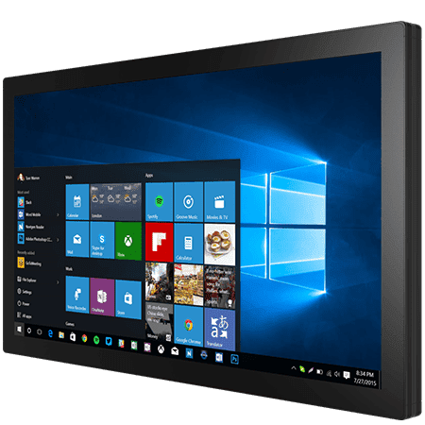
Fiber Laser Marking
QR Code Generation Software & Laser Controller Software
1. Laser Source:
Material and Application dependent sources available.
Choice depends on material to be marked and desired mark quality.
2. Optics System:
Comprises lenses and mirrors.
Focuses the laser beam to a small spot for precise marking.
Determines the accuracy and detail of the marks.
3. Galvanometer:
Consists of mirrors controlled by galvanometers.
Enables rapid movement of the laser beam for accurate positioning.
Crucial for intricate designs and patterns.
4. Workstation:
Platform where the material is placed.
May include fixtures to securely hold the material.
Allows precise positioning of the material for marking.
5. Cooling & Exhaust Systems:
Cooling system prevents overheating of the laser source.
Exhaust system removes fumes and debris generated during marking.
Essential for maintaining optimal performance and a safe working environment.
Notes:
Work Station ( Fixture) is where the component gets loaded and is kept infront of the laser for being marked. Various safety conditions are designed such that while marking, no human is hard. Cooling system is important for lasers like CO2 and Fiber since they generate immense about of Heat. Therefore, the controller and Galvo needs to be cooled down to about 24C inorder to improve its life. For Comparison, a 30W source usually has a life of 5-10years depending upon usage. When the laser is marking, with heat it will also generate dust if it’s a metallic surface, which can be removed using a suction system to keep the Lens of Laser dustfree. (3mins)

